Slide 1
Machine Learning Workflow and Vocabulary

Slide 2
Machine Learning Workflow
Data collection
The data collection step involves gathering the learning material an algorithm will use to generate actionable knowledge. In most cases, the data will need to be combined into a single source like a text file, spreadsheet, or database.
Data exploration and preparation
The quality of any machine learning project is based largely on the quality of its input data. Thus, it is important to learn more about the data and its nuances during a practice called data exploration. Additional work is required to prepare the data for the learning process. This involves fixing or cleaning so-called "messy" data, eliminating unnecessary data, and recoding the data to conform to the learner's expected inputs.

Slide 3
Machine Learning Workflow
Model training
By the time the data has been prepared for analysis, you are likely to have a sense of what you are capable of learning from the data. The specific machine learning task chosen will inform the selection of an appropriate algorithm, and the algorithm will represent the data in the form of a model.
Model evaluation
Because each machine learning model results in a biased solution to the learning problem, it is important to evaluate how well the algorithm learns from its experience. Depending on the type of model used, you might be able to evaluate the accuracy of the model using a test dataset or you may need to develop measures of performance specific to the intended application.

Slide 4
Machine Learning Workflow
Model improvement
If better performance is needed, it becomes necessary to utilize more advanced strategies to augment the performance of the model. Sometimes, it may be necessary to switch to a different type of model altogether. You may need to supplement your data with additional data or perform additional preparatory work as in step two of this process.

Slide 5
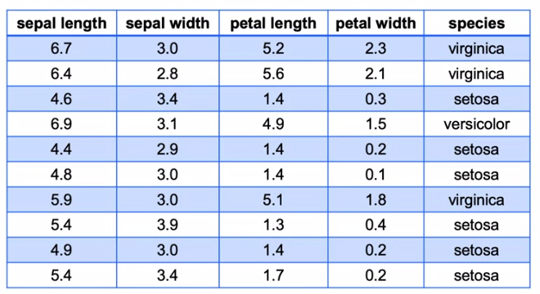
Machine Learning Vocabulary
Target: Category or value that we are trying to predict

Slide 6
Machine Learning Vocabulary
Features: Properties of the data used for prediction (explanatory data)
Note :- Features are all the columns besides the target column

Slide 7
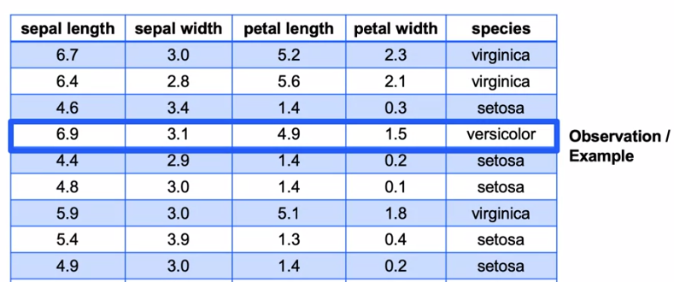
Machine Learning Vocabulary
Observation/Sample/Example: A single data point within the data (one row)

Slide 8
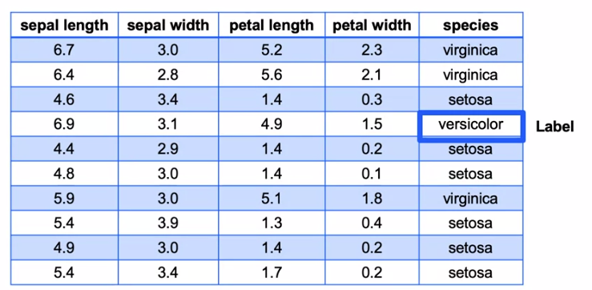
Machine Learning Vocabulary
Label: The target value for a single data point

